Slide 1


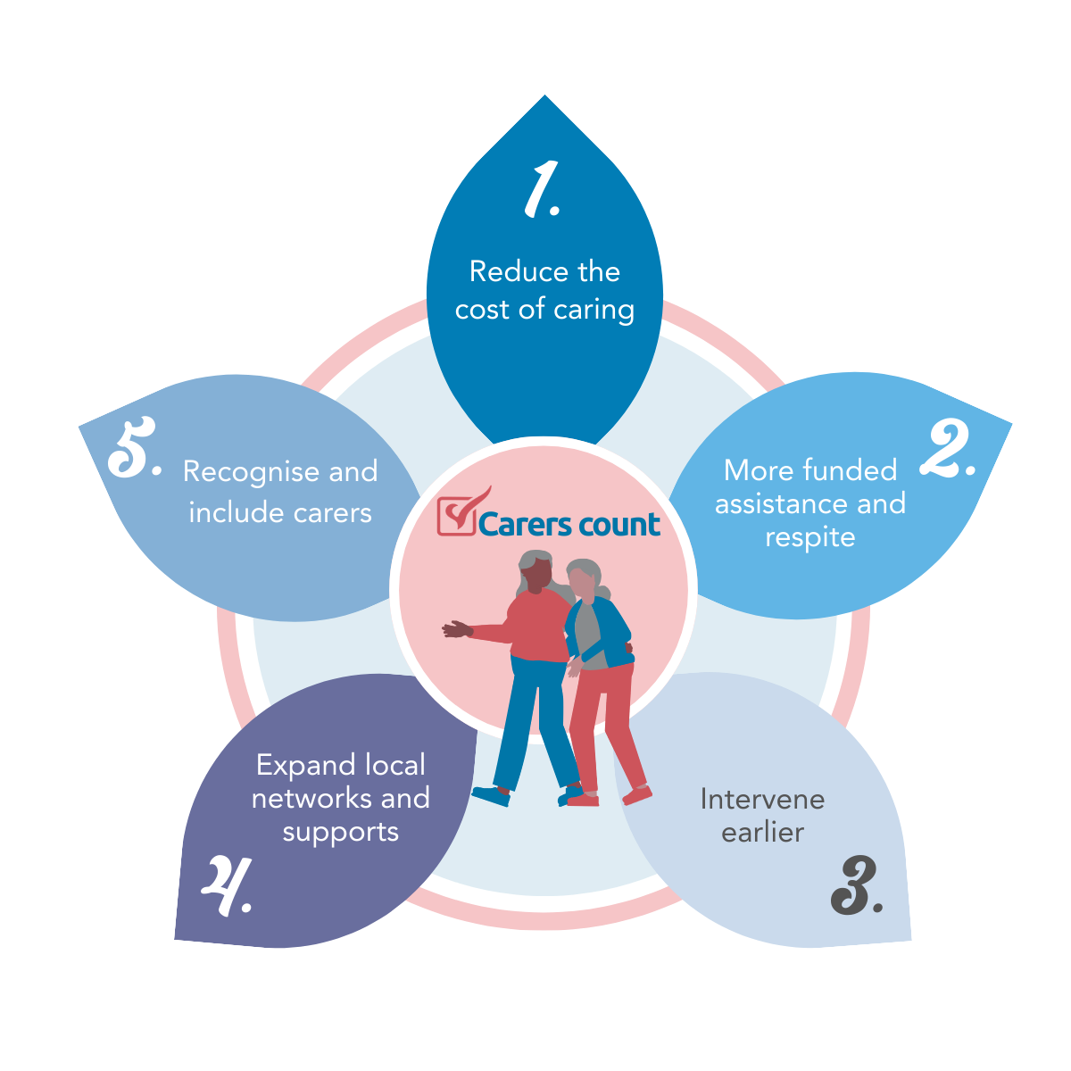

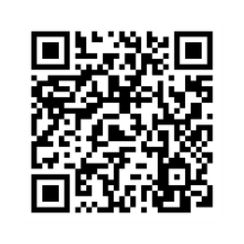

In the Victorian election ‘26
  Read our Pre-election Policy Platform
  Speak to candidates in your electorate
  Share your experience
  Spread the word
Get involved!

